Slide 1
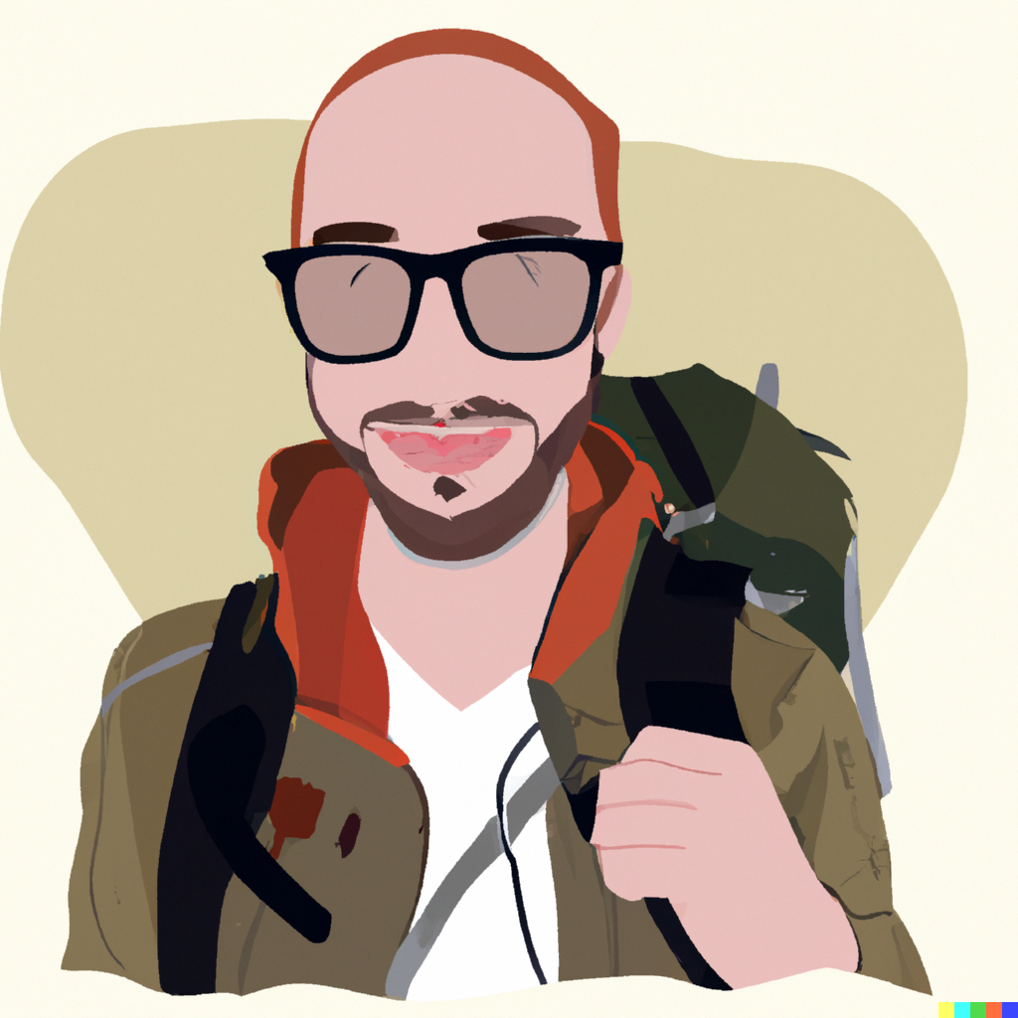
User Persona
Name and Picture
Characteristics
Need
Characteristic #1 Man who loves travelling.
Characteristic #2 Travelled to Barcelona last week.
Characteristic #3 Experiencing dry cough and sore throat.
Characteristic #4 Suspecting got affected by Covid-19.
Need #1 Need a list of hospitals available in the surroundings.
Need #2 Need to see the bed availability in that hospital.
Need #3 Need to reserve an available bed to get hospitalized.
Need #4 Access the location of the selected hospital to travel.
James Smith
Who
Why

Slide 2
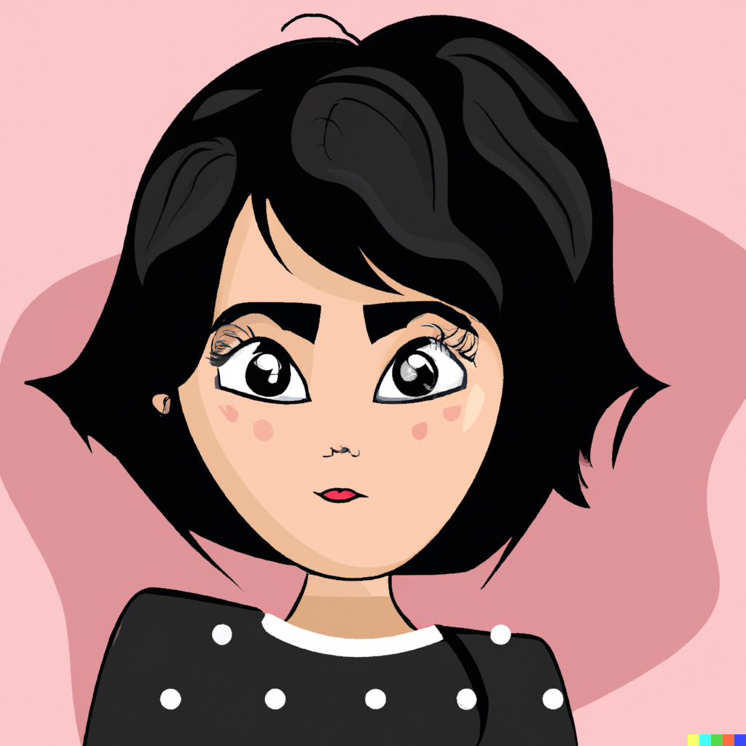
User Persona
Name and Picture
Characteristics
Need
Characteristic #1 Lady who often falls ill and gets hospitalized.
Characteristic #2 Her current health insurance is getting expired.
Characteristic #3 In search of better insurance companies
Characteristic #4 Prefers less premium to pay with the same or additional features as the current one.
Need #1 Need a list of insurance companies that are accepted by hospitals.
Need #2 View and compare the perks and benefits offered by each insurance provider.
Need #3 Need to contact the insurance provider for any clarification.
Need #4 Buy Insurance premium using the payment gateway.
Emilia Clarke
Who
Why

Slide 3

User Persona
Name and Picture
Characteristics
Need
Characteristic #1 Highly busy working married lady with two kids
Characteristic #2 Took no proper care of diet.
Characteristic #3 Experiencing increased hunger, frequent urination, and blurred vision.
Characteristic #4 Suspecting Type-2 Diabetes
Need #1 Need to know whether it is Type-2 diabetes based on symptoms.
Need #2 Need to schedule an in-home diabetic test.
Need #3 Need to access the paperless reports online.
Need #4 Need to continuously monitor the sugar levels
Sandhya Bagchi
Who
Why

Slide 4
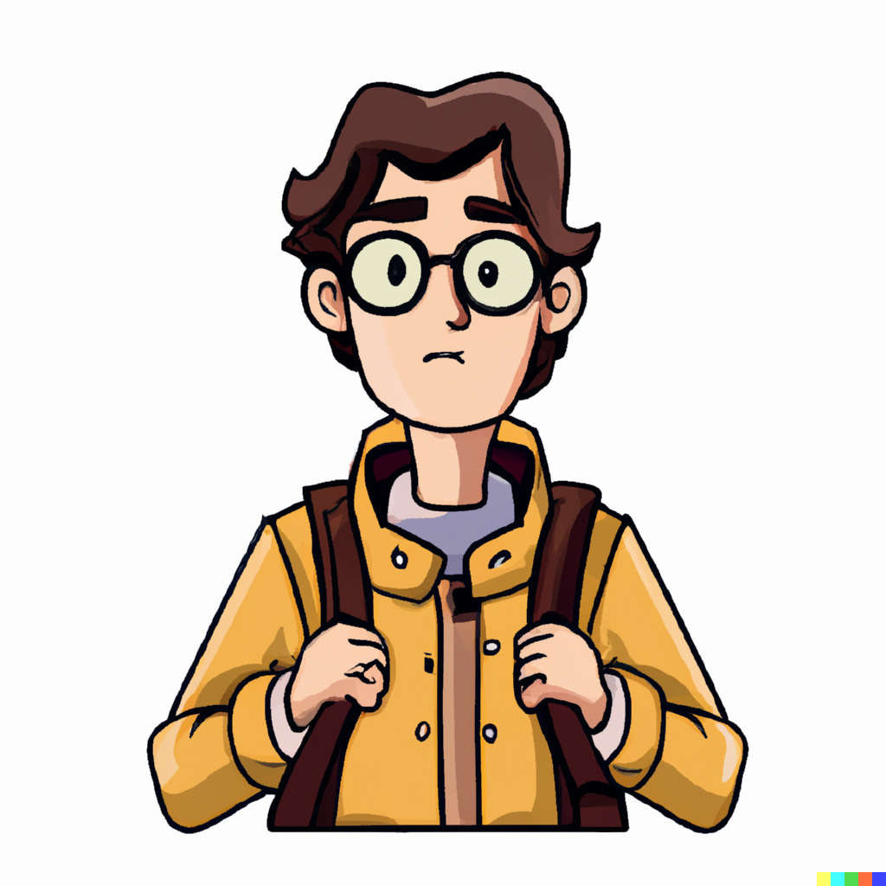
User Persona
Name and Picture
Characteristics
Need
Characteristic #1 International Student pursuing Master’s degree in the US currently in first semester of his course
Characteristic #2 Works part-time and earns $14/hr and can only work 20 hours/week.
Characteristic #3 Having severe high body temperature (possibly fever)
Characteristic #4 Cannot afford healthcare facilities in the US without health insurance reimbursement.
Need #1 Need to filter the hospitals that accept his health insurance
Need #2 Need to find subsidized and affordable healthcare facilities
Need #3 Need to book an appointment with a general physician nearby
Need #4 Need to submit insurance claim documents to the insurance provider post-treatment
Sudhanshu Malik
Who
Why

Slide 5
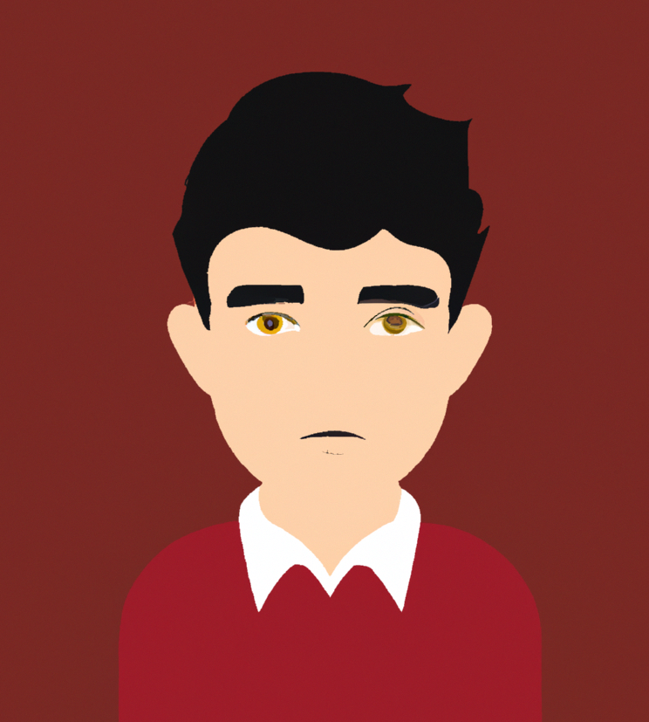
User Persona
Name and Picture
Characteristics
Need
Characteristic #1 An individual who lives alone in an apartment.
Characteristic #2 He is experiencing severe body pains.
Characteristic #3 He desires to get some pain relief spray to relieve his pains.
Characteristic #4 But he doesn’t know where to get the required pain relief spray.
Need #1 Need to get the list of pharmacies available in 3 miles range.
Need #2 Need to filter the open pharmacies.
Need #3 Need to compare the cost of pain relief spray between different pharmacies.
Need#4 Need to navigate to the selected pharmacy to buy the required items.
Chirayu Varma
Who
Why

Slide 6
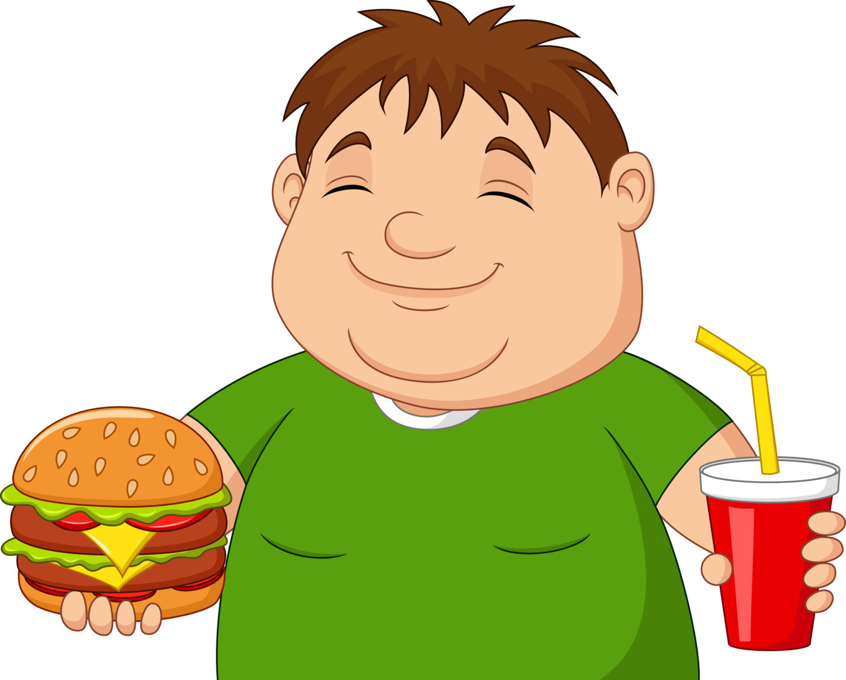
User Persona
Name and Picture
Characteristics
Need
Characteristic #1 Person who is working from home.
Characteristic #2 A big foodie and doesn’t involve in any physical activities.
Characteristic #3 Gained 30kgs weight in last 3 years.
Characteristic #4 Feeling very difficult to move out for a small walk and do things by his own.
Need #1 Need to undergo liposuction surgery.
Need #2 Need to search for hospitals and the list of surgeries that they can perform.
Need #3 Need to check the success ratio of liposuction surgery in various hospitals.
Need #4 Need to check the doctor’s availability to register for liposuction surgery.
Deepanshu Kumar
Who
Why

Slide 7
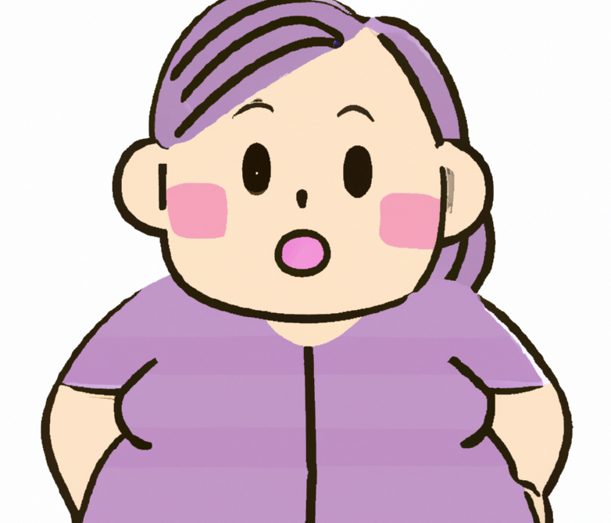
User Persona
Name and Picture
Characteristics
Need
Characteristic #1 Middle-aged woman working at McDonald’s
Characteristic #2 Having high blood pressure
Characteristic #3 Experiencing severe chest pain
Characteristic #4 Observed nose bleeding
Need #1 Need to check the doctor’s profile and find a suitable one.
Need #2 Need to go to the hospital for consultation
Need #3 Need to inform the insurance provider to get cashless treatment approved.
Need #4 Need to show the past medical history to the doctor, to speed up the treatment process.
Anjali Mehta
Who
Why

Slide 8

User Persona
Name and Picture
Characteristics
Need
Characteristic #1 Executive Manager of a hospital
Characteristic #2 Ensures proper functioning of the hospital
Characteristic #3 Assigns daily staff to the respective departments
Characteristic #4 Ensures proper hygiene in the hospital
Need #1 Need to have his hospital listed in an application
Need #2 Need to constantly update the bed availability in the application to let patients reserve the bed.
Need #3 Need to control the inflow of patients as per their appointment time.
Need #4 Need to assist patients in administration-related matters like patient first-time registration.
Venugopal Iyer
Who
Why

